Slide 1
STRUCTURAL ANALYSIS OF CORNER BRACKET
MDSP COURSE PROJECT
MDM19B042-NAMO NARAYAN
NAMO NARAYAN DHAKER
MDM19B042

Slide 2
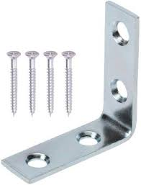
STRUCTURAL ANALYSIS OF CRANE HOOK
They are commonly used in the construction industry to strengthen corners in timber frame structures. They are also frequently used to strengthen the corner joints of furniture, such as tables and chairs

Slide 3
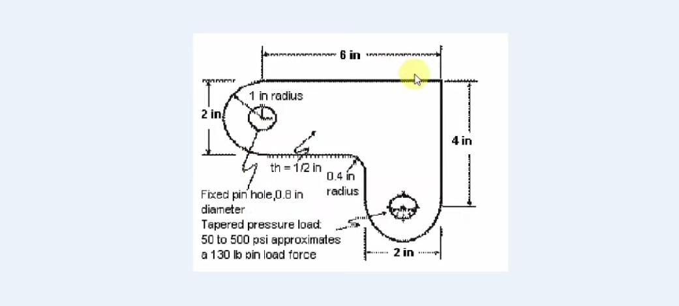
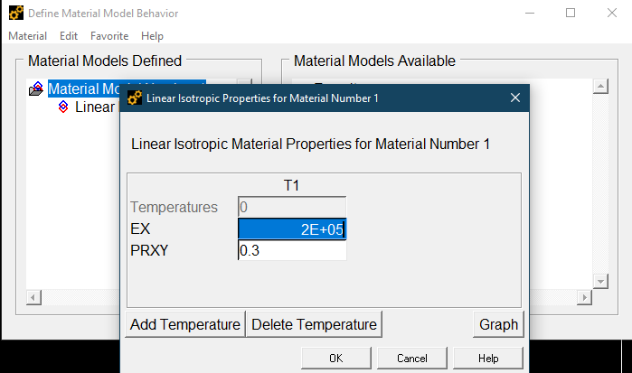
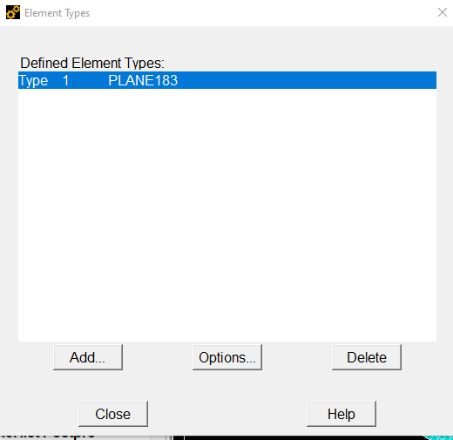
DEFINING ELEMENTS

Slide 4
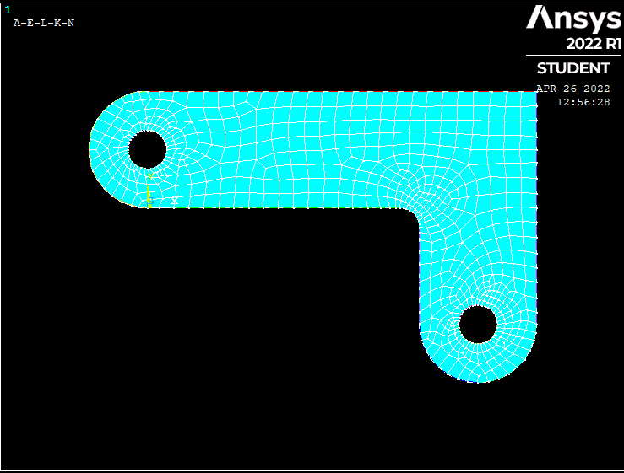
FINAL DESIGN

Slide 5
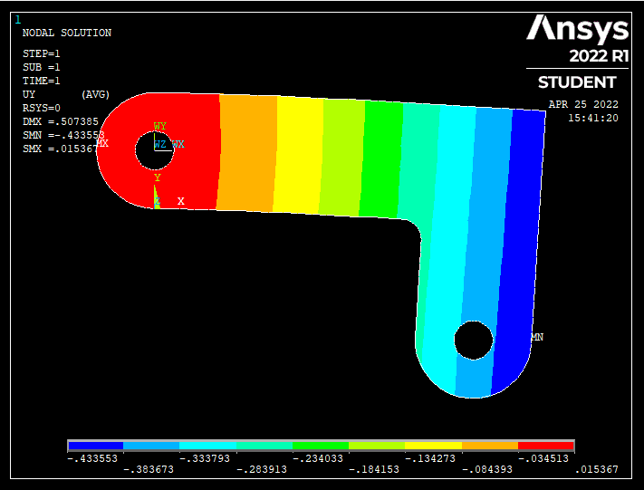
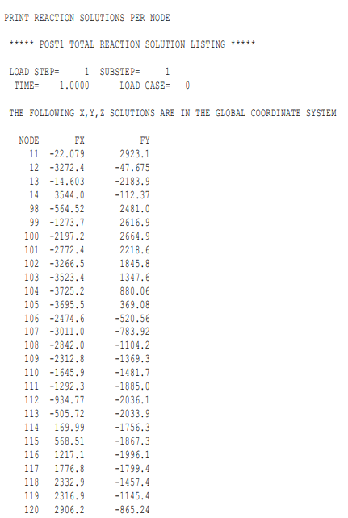
ANALYSIS:
Displacement Vector Sum

Slide 6
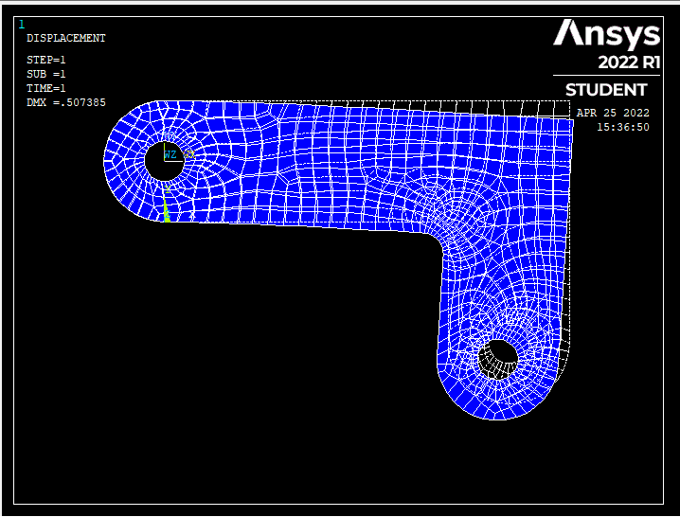
Deformed and Undeformed Shape
Blue Part: Deformed
Structural analysis of CORNER BRACKET is done with Ansys Software.
Finally we got the deformed and undeformed Shape of the CORNER BRACKET

